Slide 1

CSE 411: Artificial Intelligence
Topic – 8: Expert Systems
Department of Computer Science and Engineering
Daffodil International University
Notes:
‹#›

Slide 2
Topic Contents
Introduction
Characteristics and Limitations of an Expert System
Components of an Expert System
Participants in Developing and Using Expert Systems
Expert Systems Development
‹#›
Notes:
‹#›

Slide 3
References
“Fundamentals of Information Systems,” 8th edt., Ralph M. Stair and George W. Reynolds, Cengage Learning.
Chapter 7 (Knowledge Management and Specialized Information Systems)
“Introduction to Artificial Intelligence and Expert Systems,” D. W. Patterson, Prentice Hall of India.
Chapter 15 (Expert Systems Architectures)
‹#›
Notes:
‹#›

Slide 4

Introduction
An expert system consists of hardware and software that stores knowledge and makes inferences, enabling a novice to perform at the level of an expert.
Expert systems have many applications:
Business
Diagnosis
Industry
Etc…
‹#›
Notes:
‹#›

Slide 5

Characteristics and Limitations of an Expert System
Can explain its reasoning or suggested decisions
Can display “intelligent” behavior
Can draw conclusions from complex relationships
Can provide portable knowledge
Can deal with uncertainty
‹#›

Slide 6
Characteristics and Limitations of an Expert System…
Not widely used or tested
Difficult to use
Limited to relatively narrow problems
Cannot readily deal with “mixed” knowledge
Possibility of error
‹#›

Slide 7
Characteristics and Limitations of an Expert System…
Cannot refine its own knowledge
Difficult to maintain
May have high development costs
Expert system shell
A collection of software packages and tools used to develop expert systems
Raises legal and ethical concerns
‹#›

Slide 8
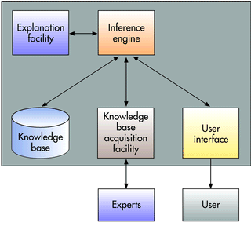
Components of an Expert System
FIGURE 7.14. Components of an expert system.
‹#›
Notes:
‹#›

Slide 9
Components of an Expert System…
An expert system consists of a collection of integrated and related components, including a knowledge base, an inference engine, an explanation facility, a knowledge base acquisition facility, and a user interface.
A diagram of a typical expert system is shown in Fig. 7.14.
In this figure, the user interacts with the interface, which interacts with the inference engine.
The inference engine interacts with the other expert system components.
These components must work together to provide expertise.
This figure also shows the inference engine coordinating the flow of knowledge to other components of the expert system.
‹#›
Notes:
‹#›

Slide 10
Components of an Expert System…
Knowledge Base
Stores all relevant information, data, rules, cases, and relationships used by the expert system.
Uses
Rules
If-then Statements
Fuzzy Logic
‹#›
‹#›
Notes:
‹#›

Slide 11
Components of an Expert System…
Inference Engine
Seeks information and relationships from the knowledge base and provides answers, predictions, and suggestions the way a human expert would.
Uses
Backward Chaining
Forward Chaining
‹#›
‹#›
Notes:
‹#›

Slide 12
Components of an Expert System…
Seeks information and relationships from the knowledge base and provides answers, predictions, and suggestions the way a human expert would.
In other words, the inference engine is the component that delivers the expert advice.
Backward chaining
Starting with conclusions and working backward to the supporting facts
Forward chaining
Starting with the facts and working forwards to the conclusions
‹#›

Slide 13
Components of an Expert System…
Explanation Facility
Allows a user to understand how the expert system arrived at certain conclusions or results.
For example: it allows a doctor to find out the logic or rationale of the diagnosis made by a medical expert system
‹#›
‹#›
Notes:
‹#›

Slide 14
Components of an Expert System…
Knowledge acquisition facility
Provide convenient and efficient means of capturing and storing all the components of the knowledge base.
Acts as an interface between experts and the knowledge base.
‹#›
‹#›
Notes:
‹#›

Slide 15
Components of an Expert System…
User Interface
Specialized user interface software employed for designing, creating, updating, and using expert systems.
The main purpose of the user interface is to make the development and use of an expert system easier for users and decision makers
‹#›
‹#›
Notes:
‹#›

Slide 16
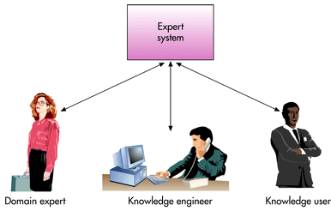
Participants in Developing and Using Expert Systems
‹#›
Notes:
‹#›

Slide 17
Participants in Developing and Using Expert Systems…
Domain
The area of knowledge addressed by the expert system
Domain Expert
The individual or group who has the expertise or knowledge one is trying to capture in the expert system
Knowledge Engineer
An individual who has training or expertise in the design, development, implementation, and maintenance of an expert system
Knowledge User
The individual or group who uses and benefits from the expert system
‹#›
Notes:
‹#›

Slide 18


Expert Systems Development
Steps in the expert system development process
‹#›
Notes:
‹#›

Slide 19

THANKS…

